Slide 1
Custom components pt 6 – lifecycle hooks
Encapsulated, single-responsibility, reusable code

Slide 2

Contents
What is a lifecycle?
What is a hook?
Why do we need it?
How to use it?

Slide 3
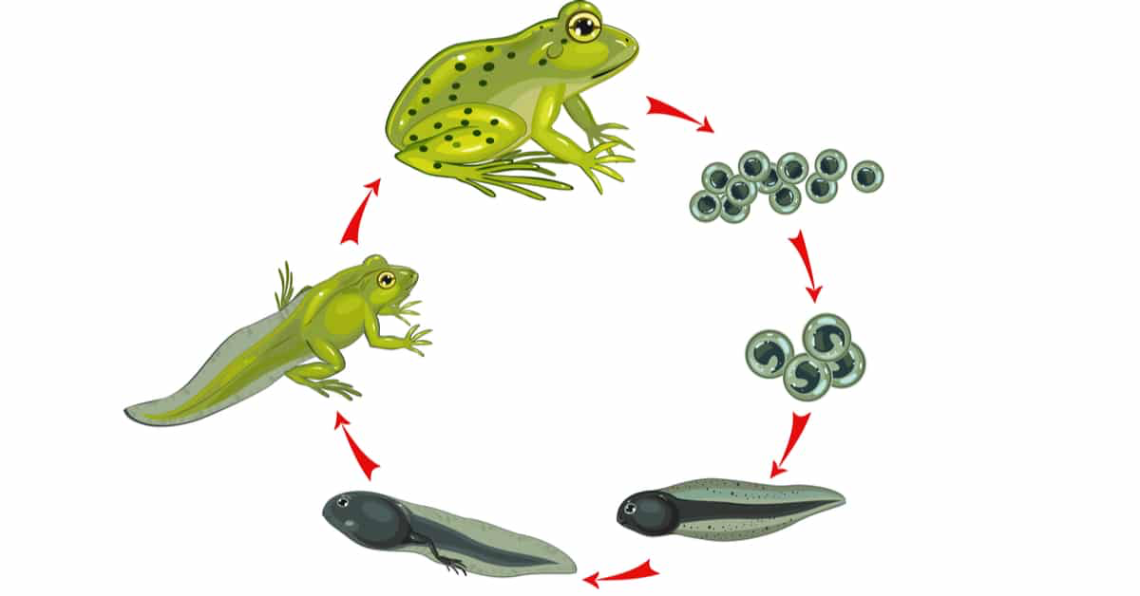
What is a lifecycle?
the series of changes in the life of an organism including reproduction.

Slide 4
Java Object example
The constructor is called. That is a lifecycle function.
// Create a new Object (the object is “born”)
Object object = new Object();
// Execute functions with the object (the object is “alive”)
object.doSomething();
object.doSomethingElse();
// Remove the object (the object “dies”)
object = null;
The main part of the lifecycle
The destructor is called. Also a lifecycle function
In java the garbage collector “cleans up” after you!

Slide 5
Object lifecycle
create Object
remove Object
use Object

Slide 6
Lifecycles in web components
Called when the object is created
We have already seen and used several lifecycle functions
constructor()
connectedCallback()
disconnectedCallback()
observedAttributes()
attributeChangedCallback()
Called when the object is added to the DOM
Called when the object is removed from the DOM
Called when an ‘observed’ attribute changes value
Called when the object is added to the DOM

Slide 7
Lifecycles in web components
Notice we never call the functions directly
They are called for us
We often refer to these kind of functions as ‘hooks’
Therefore lifecycle hooks
You do not NEED to use them
But they are very usefull!

Slide 8
Lifecycles in web components
create object
add to DOM
active
remove from DOM
constructor()
connected
Callback()
disconnected
Callback()
observed
Attributes()
attribute
Changed
Callback()

Slide 9
Usage
Initialisation
attributes
event listeners
data exchange
Listen to attribute changes
Cleanup
remove event listeners

Slide 10
Conclusion
Lifecycle hooks are functions that
you never call
are called by the system when appropriate
can be used for initialization, change management en cleanup

